Slide 1
Basics on Simulation with ZEUS-MP
Paros Kwan King Hong
29/12/2014
Supervisor : Dr Leung Po Kin
Prof Li Hua-Bai

Slide 2
Content
Introduction
Set of Physics equations
Physics equations
expected phenomena – MHD wave
Simulation techniques and their implementation in Zeus-MP
Operator splitting
Straggled mesh
Artificial viscosity
MOCCT
Sample problems by Zeus-MP
Brio and Wu Tube
Kelvin Helmholtz instability

Slide 3
Introduction

Slide 4
List of Reading :
Book
Thompson, An Introduction to Astrophysical Fluid Dynamics, Imperial (2006)
Schnack, Lectures in Magnetohydrodynamics, Springer (2009)
Faber, Fluid Dynamics for Physicists, Cambridge (1995)
Paper
ZEUS-2D: A radiation megnetohydrodynamics ode for astrophysical lows in two space dimensions. I. The hydrodynamic algorithms and test ; (Stone & Norman 1992) II. The megnetohydrodynamic algorithms and test (Stone & Norman 1992)
Simulating radiating and magnetized flows in multiple dimensions with ZEUS-MP(Hayes 2006)

Slide 5
Introduction : Zeus -MP
The first ZEUS code was developed by Clarke(1986)
In 1992, Stone & Norman published an often-cited trio of papers, documented ZEUS-2D
After years of development, Hayes documented ZEUS – MP
ZEUS – MP is compactable on solving HD, ideal MHD, RHD, with self gravity in varies geometry and boundary conditions, with parallelism
In this presentation, RHD and self-gravity and parallelism wont be included

Slide 6
Physics

Slide 7
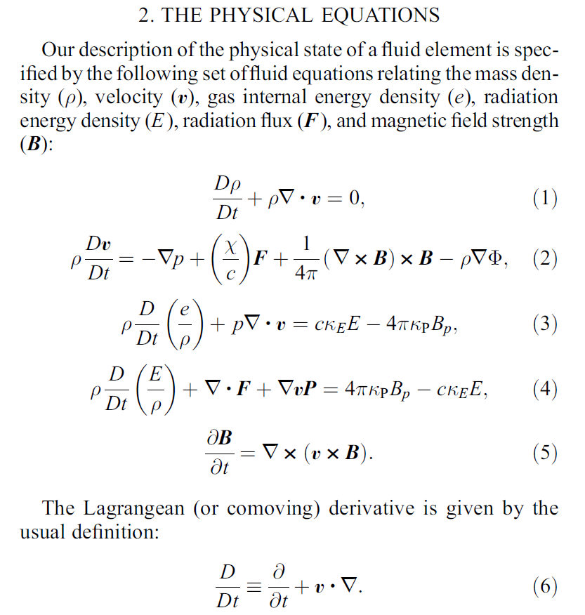
Physics - equations
Hayes et al (2006)

Slide 8
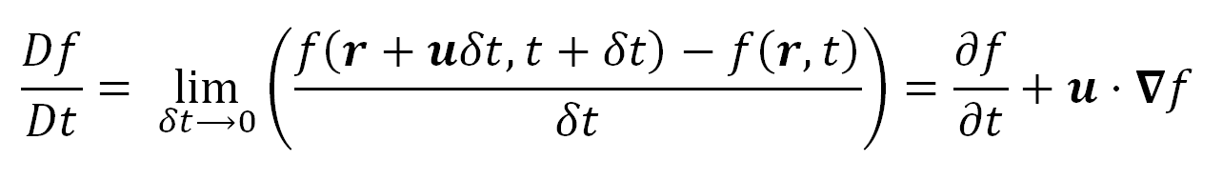
Time derivative
Eularian time derivative : ∂/∂t at the coordinate fixed at lab frame
Lagrangean derivative D/Dt follow the fluid element
The adaptive-mesh derivative follow the moving mesh
Lagrangean vs Eularian

Slide 9
MHD wave – Why ?
THE proof is quiet similar in investigating wave/ instability
Usual Steps :
Introduce little perturbation to system of equation
To guess a plane wave solution
Obtain the dispersion relation
Learn MHD wave in 5 minutes !

Slide 10
MHD wave – Assumption
Ideal MHD is considered (resistance → 0)
Without gravity
Without radiation
Adiabatic equation of state
Zero viscosity
Small perturbation → cross term of two perturbed term vanish

Slide 11
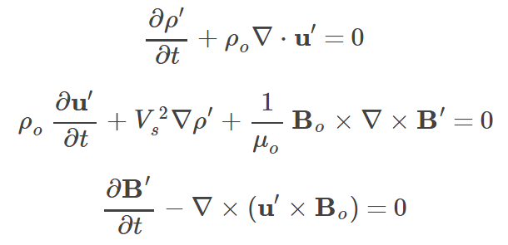

MHD wave – Proof
Consider equation of continuity, momentum equation and Maxwell equation
The pressure gradient is replace by density gradient by adiabatic condition :
substitute (7a) and (7c) in ∂(7a)/∂t
(7a)
(7b)
(7c)
(7d)

Slide 12
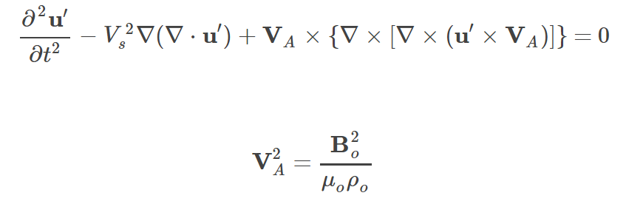
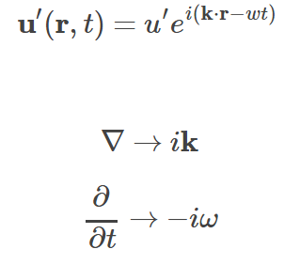
MHD wave – Proof
The equation become :
With V_{A} :
Told you we are expecting wave ! So we ‘guess’ plane wave :
Operator is then :
(8a)
(8b)
(9a)
(9b)
(9c)

Slide 13
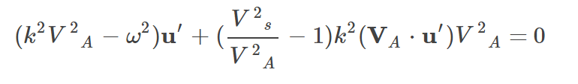
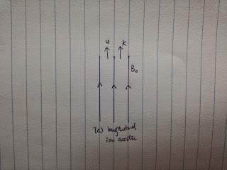

MHD wave – Proof
Dispersion relation:
Generally difficult to solve, but we can see the physics in special case
Case 1 : k//B_{o} k•V_{A} → kV_{A}
The dispersion relation is now
Further assume Case 1a u’//B_{o}
Which is sound wave
(10)
(11)

Slide 14
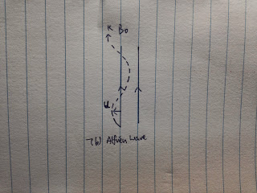

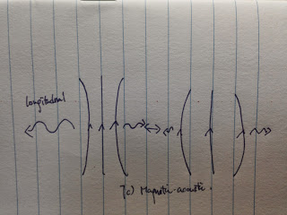

MHD wave – Proof
assume case 1b u’⊥B_{o}
Which is Alfvén wave!
assume case 2 k⊥B_{o}
Which is magnetic-acoustic wave!

Slide 15
Numerical Methods

Slide 16
Numerical Methods
Finite Different
Operator splitting
Straggled mesh
Artificial viscosity
MOCCT
First introduce the hydrodynamic, then MHD (just like in the paper)

Slide 17
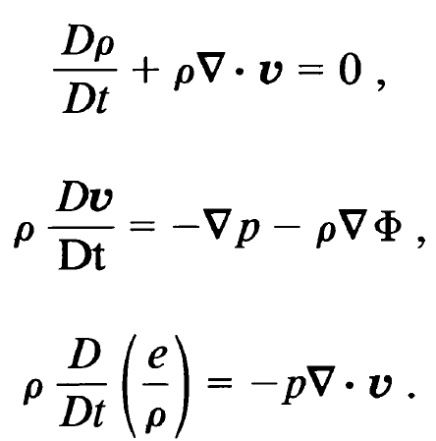
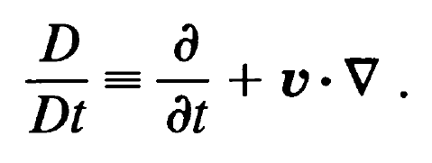
Hydro-Dynamics
Extract the pure hydro part :
with
(12a)
(12b)
(12c)
(12d)
Stone & Norman(1992)

Slide 18
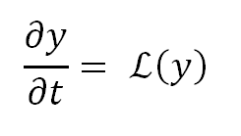

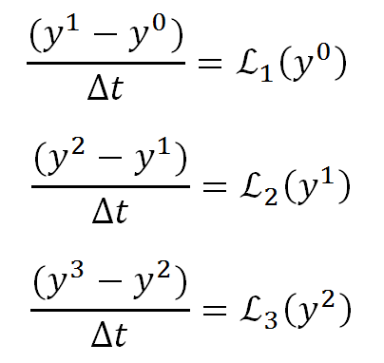
HD – Operator Splitting
Operator splitting break PDEs into parts
E.g. for equation:
We assume that the operator an split into part
y is evaluated :
Notes:
Mention the advantage

Slide 19
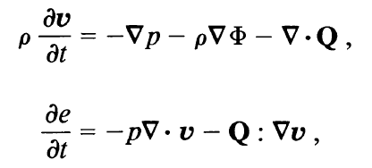
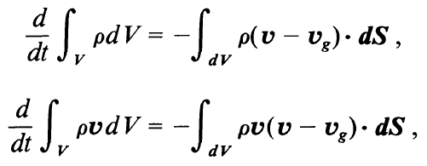

HD – Operator Splitting
The set of HD eqn is then grouped into two step, namely :
Source step :
And transport step

Slide 20
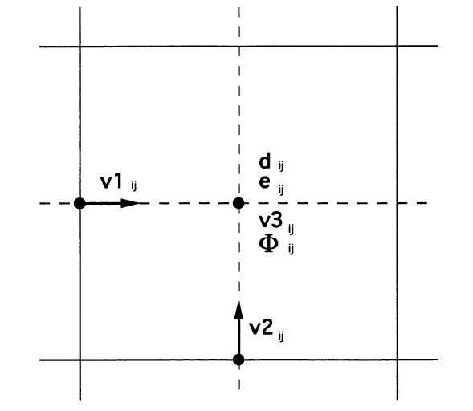
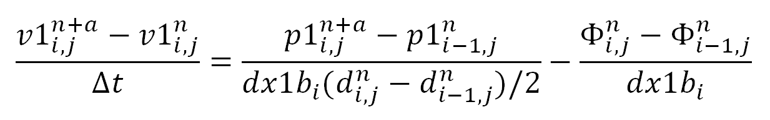
HD – the staggered mesh
Vector from differencing scalar are in centered location between the scalar ,
centered differences are second order accurate
Number of interpolation is reduced for advection equation
The equation is then solved by finite different method: e.g. in the first substep of source term:
finite different form:
Position of variable, note that this graph is for ZEUS -2D

Slide 21
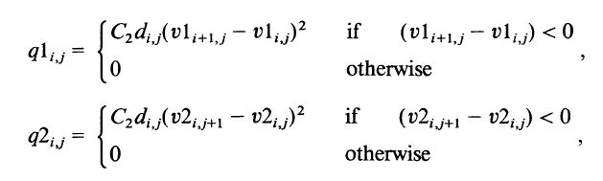
HD artificial viscosity
In source step, artificial viscosity is added to smooth discontinuities, which proposed by von Neumann & Richtmyer
Non-linear viscosity is added, such that it is large in shock but small elsewhere
V_{i} | V_{i+1} | q
5 | 0 | yes
0 | 5 | no
0 | -5 | yes
-5 | 0 | no
Notes:
Rankine–Hugoniot conditions

Slide 22
Integral forms of transport equation is used, such that the total quantity of advected variable is conserved
The transport step is measured on a moving grid with velocity v_{g} , to provide some degree of freedom like
Equal the grid velocity to fluid velocity

Slide 23
Magneto-Hydro-Dynamics
Compare to HD
Divergence free condition
New families of wave
New method called MOC-CT is introduced: Method Of Characteristic – Constrained Transport

Slide 24

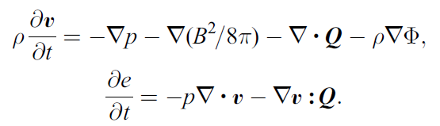
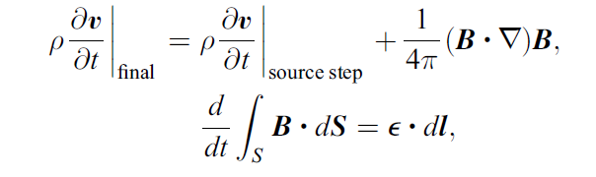

MHD – New terms
Magnetic pressure
Magnetic-acoustic wave
Momentum equation:
The operator spited equation become:
Followed by MOCCT step:
with
Magnetic tension
Alfven wave

Slide 25
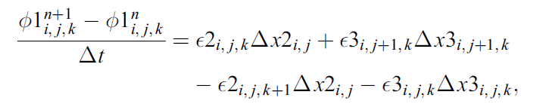
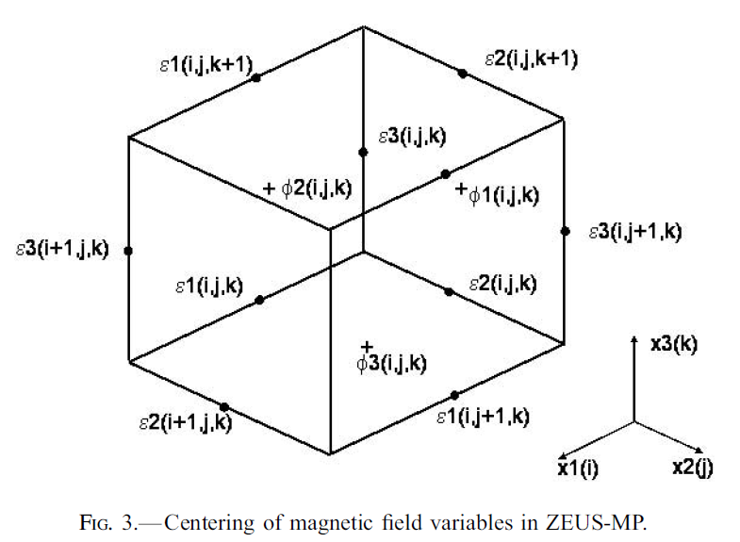
MOCCT
The divergence free condition is guaranteed as long as the emf are evaluated one and only once per time step (Stone & Norman 1992b)
But how to calculate emf?

Slide 26
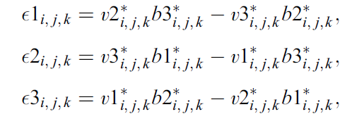
MOC
E = v x B
Just the value is time centered value,
They are computed by consider alfven wave only???

Slide 27
Courant condition
To make sure that the information transfer is smaller then one grid in one time step
Min(Δx) > (c_{f} + |u|) Δt

Slide 28
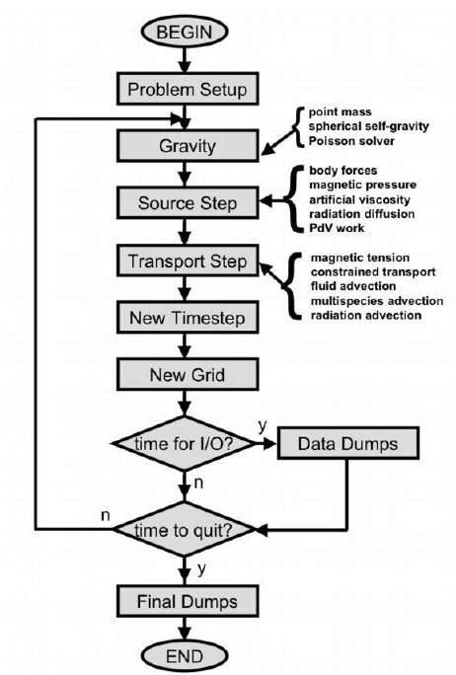
ZEUS – MP overall
Hayes et al (2006)

Slide 29
Sample Problems

Slide 30
Examples by Zeus - MP
Brio and Wu Tube
Kelvin Helmholtz instability

Slide 31
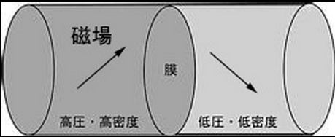
BW tube - background
Brio and Wu proposed this problem in their paper (1988)
Which is a shock tube with magnetic field
This problem in included in the ZEUS –MP code as standard test

Slide 32
BW tube - Setup
The problem is with two discontinuous
1D problem
For γ = 2 gas
Left : (P,ρ,Bx,By,Bz ) = (1.0, 1.0,0.75,0.6,0.8)
Right : (P,ρ,Bx,By,Bz ) = (0.1, 0.125,0.75,-0.6,-0.8)
800 Zone ,run from t = 0 to t = 100
outflow boundary condition

Slide 33
BW tube - Result
Density against x

Slide 34
BW tube - Discussion
The result is compare by BW and Zeus-2D (mentioned in the paper) by L1 error norm test
shock
rarefaction
Fast rarefaction
Compound wave*
Contact discontinuity
Notes:
Cd : pressure continous, differne density/ temperture

Slide 35
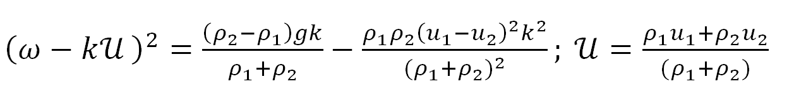
KH instability- background(incomplete)
Occur when there is a velocity difference across interface of two fluids
The proof is not given here, but the step
A scalar flow is used to perturb the velocity of particle at boundary
Only linear terms are kept
the pressure is kept continuous at boundary
Find the dispersion relation

Slide 36
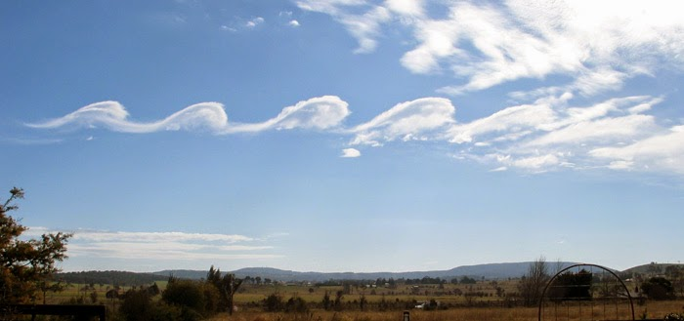
KH instability- Setup
y=0.5
Wikipedia
y=0.25
Vy amp = 0.01
x=-0.5
x=0.5
P = 2.5
ρ = 2
Vx = -0.5
P = 2.5
ρ = 1
Vx = 0.5
y=-0.25
Grid : 200 x 200
Boundary condition : periodic everywhere
ϒ = 1.4 everywhere
y=-0.5

Slide 37
KH instability - Result

Slide 38
KH instability – discussion

